Slide 1
Social Studies
Student Programs
Notes:
Good afternoon everyone, with me here today is my assistant Veronica, who is always able to answer any questions you might have.
Please remember that this webinar will be recorded and posted on both the WVDE Social Studies website as well as the WV State Social Studies Fair & History Day website. It will take a few days to share the information and get the recording posted. When the recording is available, an email will be sent out.

Slide 2
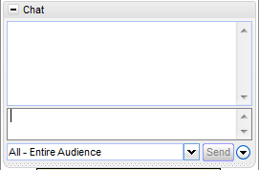
GoTo Meeting
If you have any questions, please send us the questions via chat.
We will answer all questions during the Q & A sections of the Webinar.

Slide 3
Social Studies Contacts
Name | Title | E-Mail
Robert “Joey” Wiseman | WVDE, Office of Secondary Learning, Assistant Director | rjwisema@access.k12.wv.us
Veronica Barron | WVDE, Office of Secondary Learning, Program Assistant | vbarron@access.k12.wv.us
Chris Treadway | Social Studies Fair Project Manager | help@wvssfair.com
Name of Website | Web address
WVDE State Social Studies Website | http://wvde.state.wv.us/socialstudies/
WV State Social Studies Fair & History Day Website | http://www.wvssfair.com

Slide 4
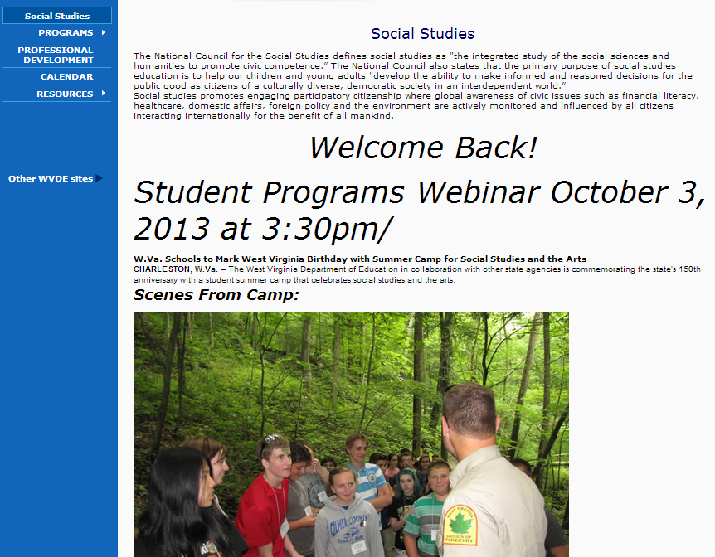
WVDE Social Studies Website
http://wvde.state.wv.us/socialstudies/
Notes:
Let me remind you that the WVDE Social Studies Website is updated weekly. It is full of information for social studies teacher.
The main page always has announcements and upcoming events for the month.

Slide 5
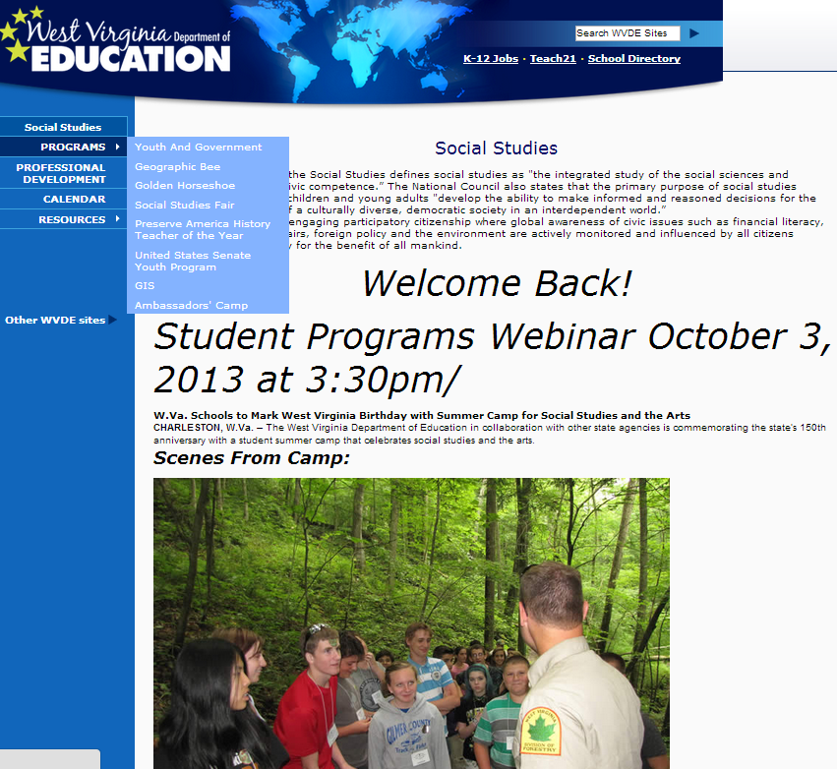
Student Programs

Slide 6
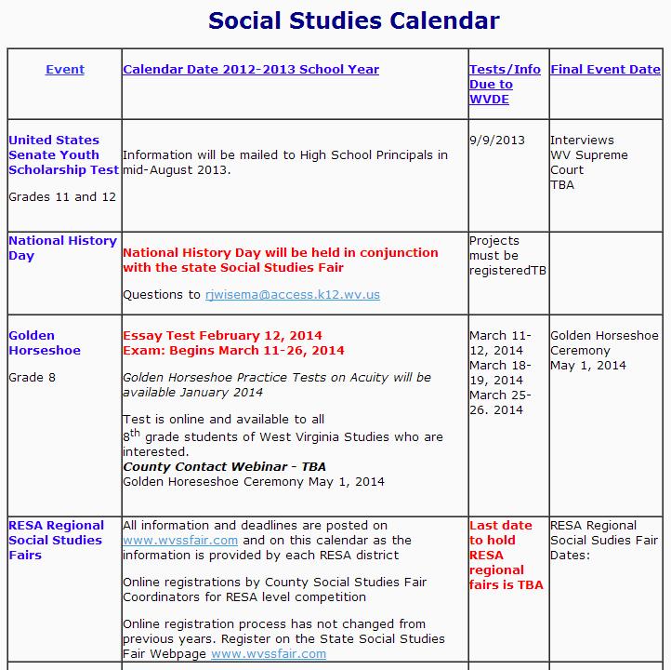
Notes:
This is just a few of the dates that are currently listed on this calendar. Not showing are the dates for the WV State Social Studies Fair & History Day, National Geographic State Bee, National History Teacher of the Year, Youth and Government, We the People, GIS PD dates and The WV History Bowl.

Slide 7

Golden Horseshoe
Ceremony – May 1, 2014

Slide 8
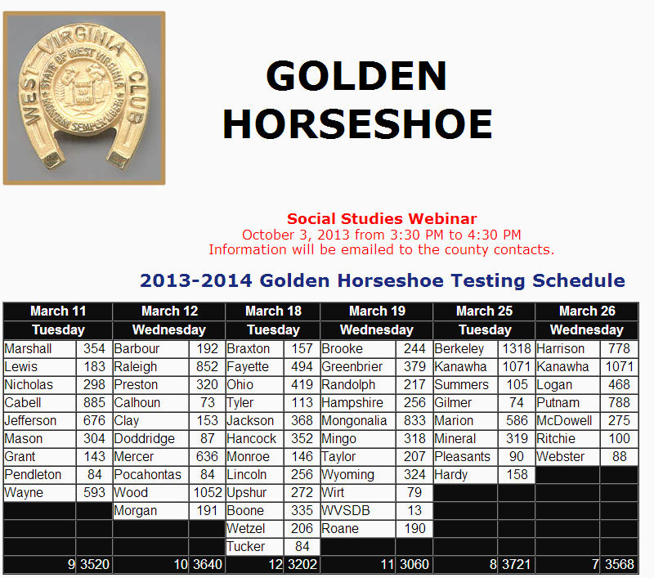
Notes:
The Golden Horseshoe Webpage…
Last year was the first year that we recorded the Golden Horseshoe Ceremony. The link to the Ceremony video is found at the top of the page along with a copy of last year’s program.
Again, we have posted all the information pertaining to Golden Horseshoe right here on the webpage.
The testing schedule is slightly different this year. We are testing counties for three weeks but for only two days each week. The test schedule will be finalized on October 1; so if you have any changes, please contact Joey Wiseman.
Again, we will not be e-mailing the forms out, they are posted on the Golden Horseshoe webpage and can be obtained at any time.

Slide 9
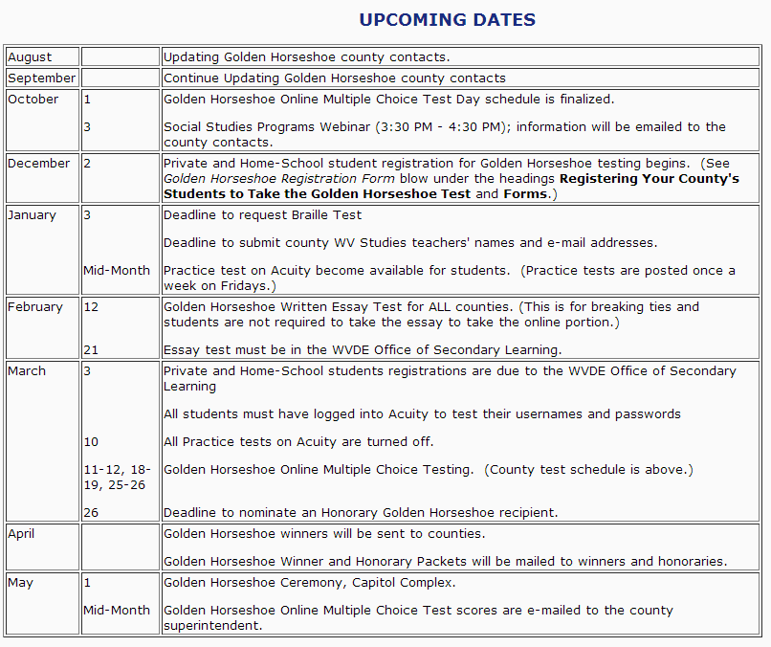
Notes:
Upcoming dates
Here is a list of all the upcoming dates for this program.

Slide 10
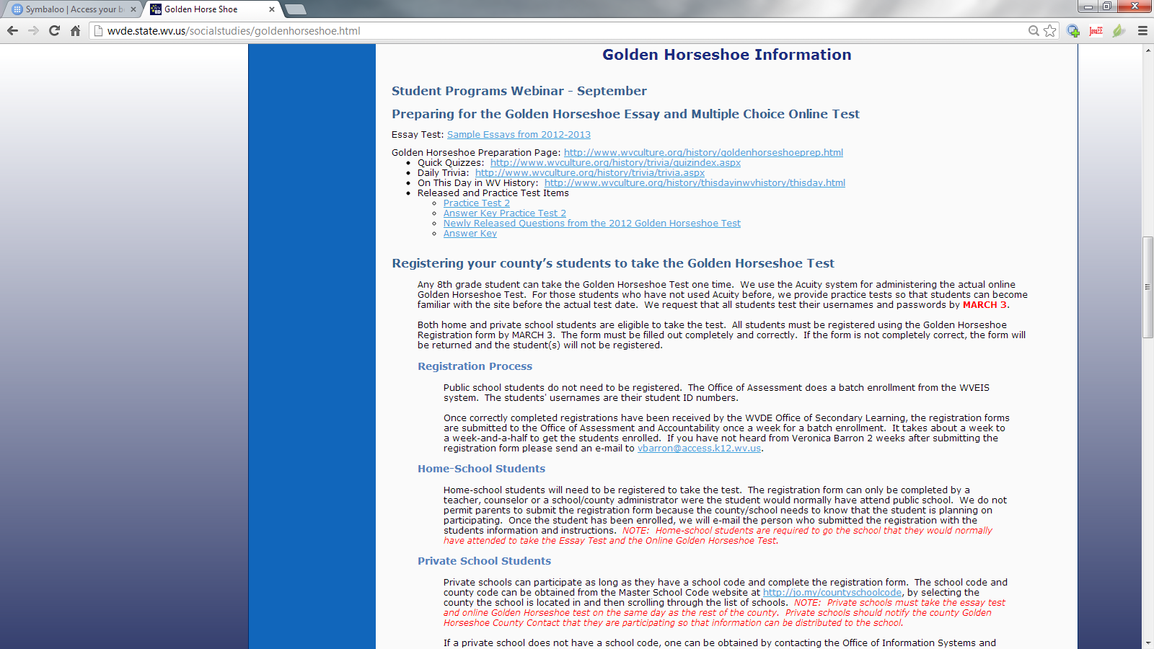
Notes:
Preparing for the Golden Horseshoe Essay and Multiple Choice Online Test
Registering Your County’s students to take the Golden Horseshoe Test
Registration Process
Home-School Students
Private School Students

Slide 11
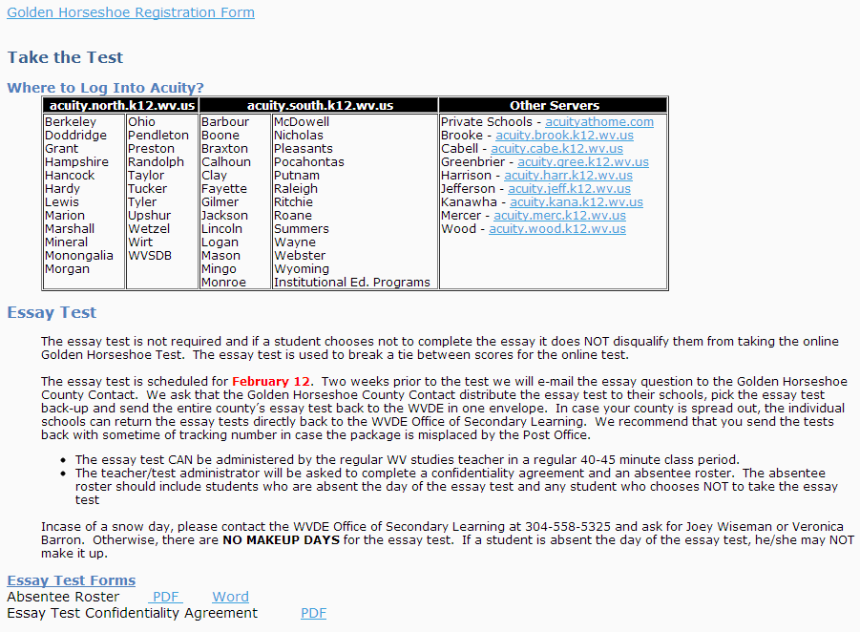
Notes:
The registration from can be found directly under the Private School Students heading.
Take the Test
Where to Log Into Acuity
Essay Test
The essay test can be given by the regular WV studies teacher in the regular WV studies class. The essay test was designed to be given in a 40-45 minute class period. The WV studies teacher will need to sign the confidentiality agreement and mail it back with the absentee roster and the alphabetized essay test.

Slide 12
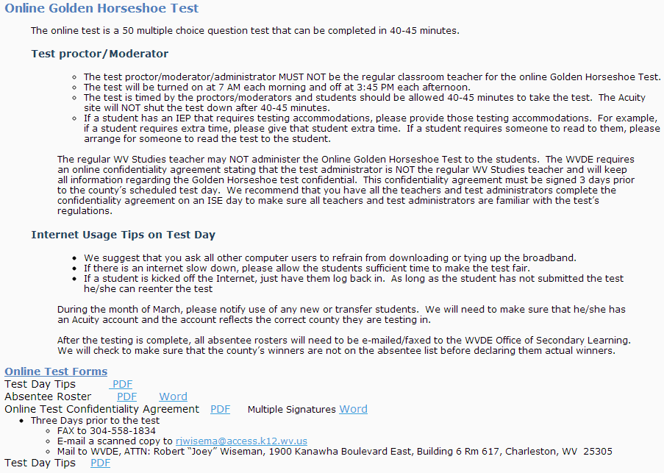
Notes:
Online Golden Horseshoe Test
The test is 50 multiple choice question test that can be completed in a 40-45 minute class period but the regular WV studies teacher cannot administer the test. The confidentiality agreement must be signed and turned into the Office of Secondary Learning three days prior to testing. We have designed a multiple signature confidentiality agreement. A school/county can have up to 10 signatures on the multiple signature confidentiality agreement. We recommend that you do the online test confidentiality agreement when the county/school returns their essay tests to the WVDE Office of Secondary Learning. If by chance you have already submitted the confidentiality agreement and for some reason the test administrator has to be changed, send a new agreement ASAP.
If the school/county is experience any issues, Mr. Wiseman and/or I need to be notified immediately. We request that the school/teacher/county having the issue contact us.
In regards to the Absentee Roster, we need the absentee roster from every school participating. Even if it is an email that says no absences. Schools/teachers can submit the absentee rosters either by email or fax. Remember the absentee roster includes students who choose not to take the test.

Slide 13
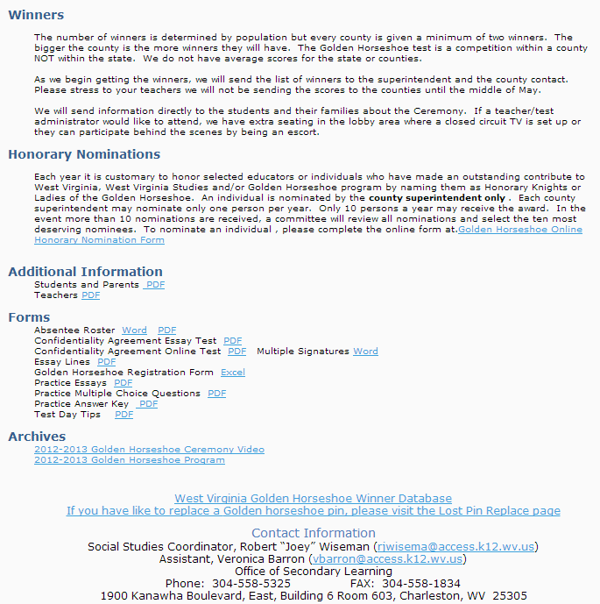
Notes:
Winners
Honorary Nominations
Additional Information
All forms mentioned through out the webpage can also be found at the very bottom of the page. Remember that we will not be emailing the confidentiality agreement or the test day times.

Slide 14

Notes:
Questions?
What are the county contacts responsible for?

Slide 15
State Social Studies Fair & History Day
April 11, 2013

Slide 16
Information for Students
ALL high school students are moving to the History Day portion of the State Social Studies Fair.
Student sin grades 9-12 will only be eligible to participate in the History Day portion of the State Social Studies Fair. Middle school students will have a choice of participating in either the State Social Studies Fair or History Day but they cannot participate in both.
For 2013-14 ONLY, middle school students to not have to compete at the local, county or RESA level – they may come directly to the State Social Studies Fair.
NOTE: The local and regional History Day competitions will host ONLY exhibit projects for the 2013-2014 school year. Additional categories will be added in 2014-2015 and 2015-2016.

Slide 17
What Grades Participates in Social Studies Fair or History Day
Social Studies Fair
History Day
Grade | School | County | Regional | State
3 | X | X | X | X
4 | X | X | X | X
5 | X | X | X | X
6 | X | X | X | X
7 | X | X | X | X
8 | X | X | X | X
9
10
11
12
School | County | Regional | State | National
 |  |  | X | X
 |  |  | X | X
 |  |  | X | X
X | X | X | X | X
X | X | X | X | X
X | X | X | X | X
X | X | X | X | X
Notes:
ALL high school students are moving to the History Day portion of the State Social Studies Fair.
Student sin grades 9-12 will only be eligible to participate in the History Day portion of the State Social Studies Fair. Middle school students will have a choice of participating in either the State Social Studies Fair or History Day but they cannot participate in both.
For 2013-14 ONLY, middle school students to not have to compete at the local, county or RESA level – they may come directly to the State Social Studies Fair.
NOTE: The local and regional History Day competitions will host ONLY exhibit projects for the 2013-2014 school year. Additional categories will be added in 2014-2015 and 2015-2016.

Slide 18
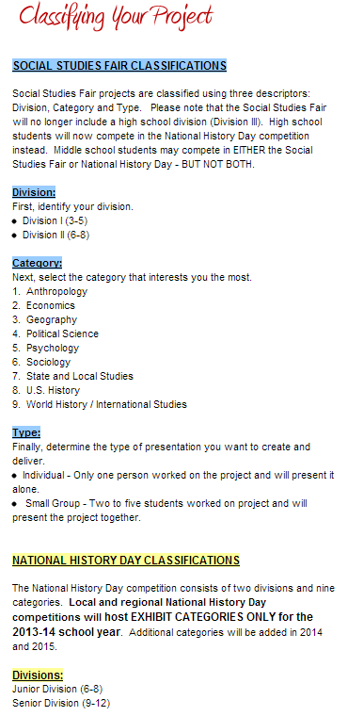
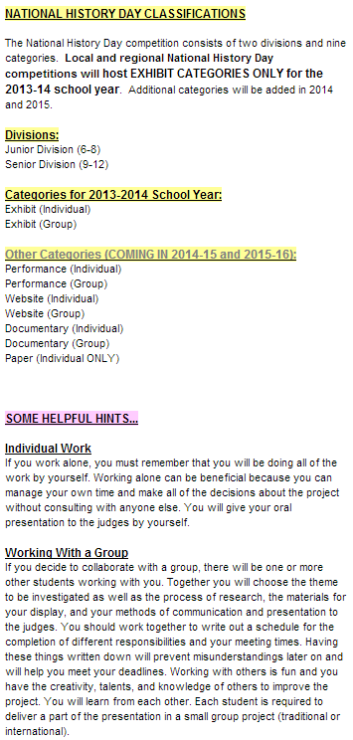
Divisions, Categories and Types (Overview)

Slide 19
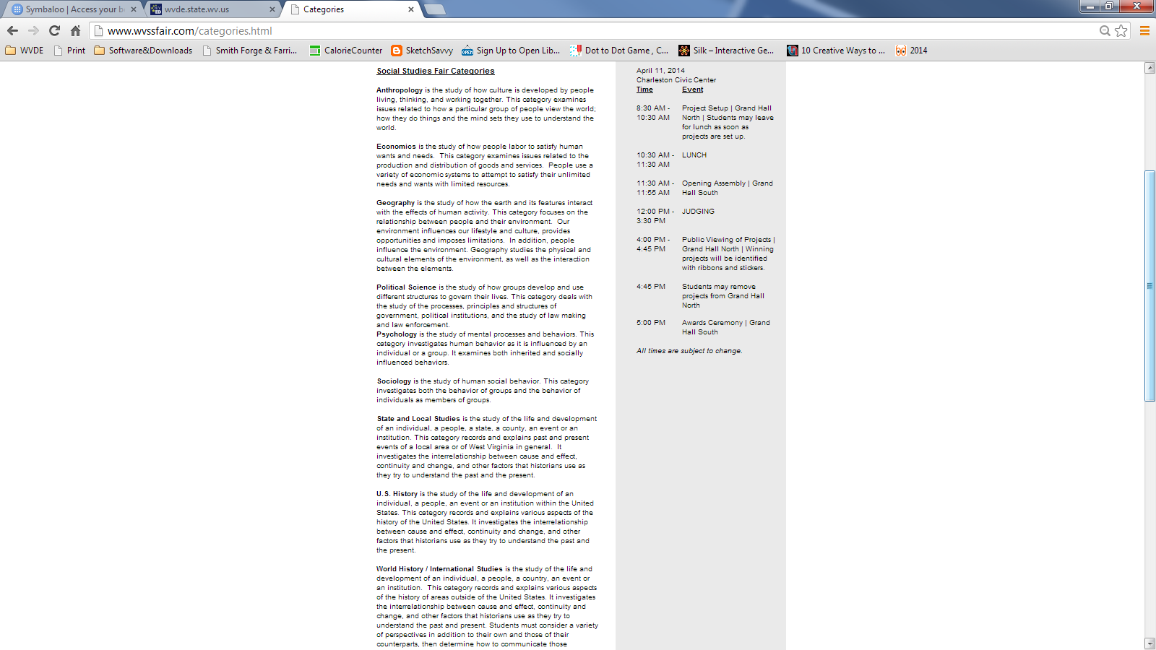
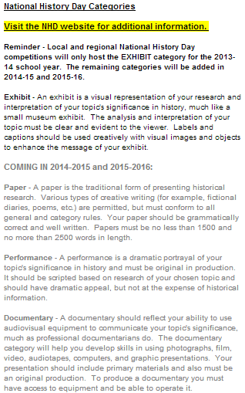
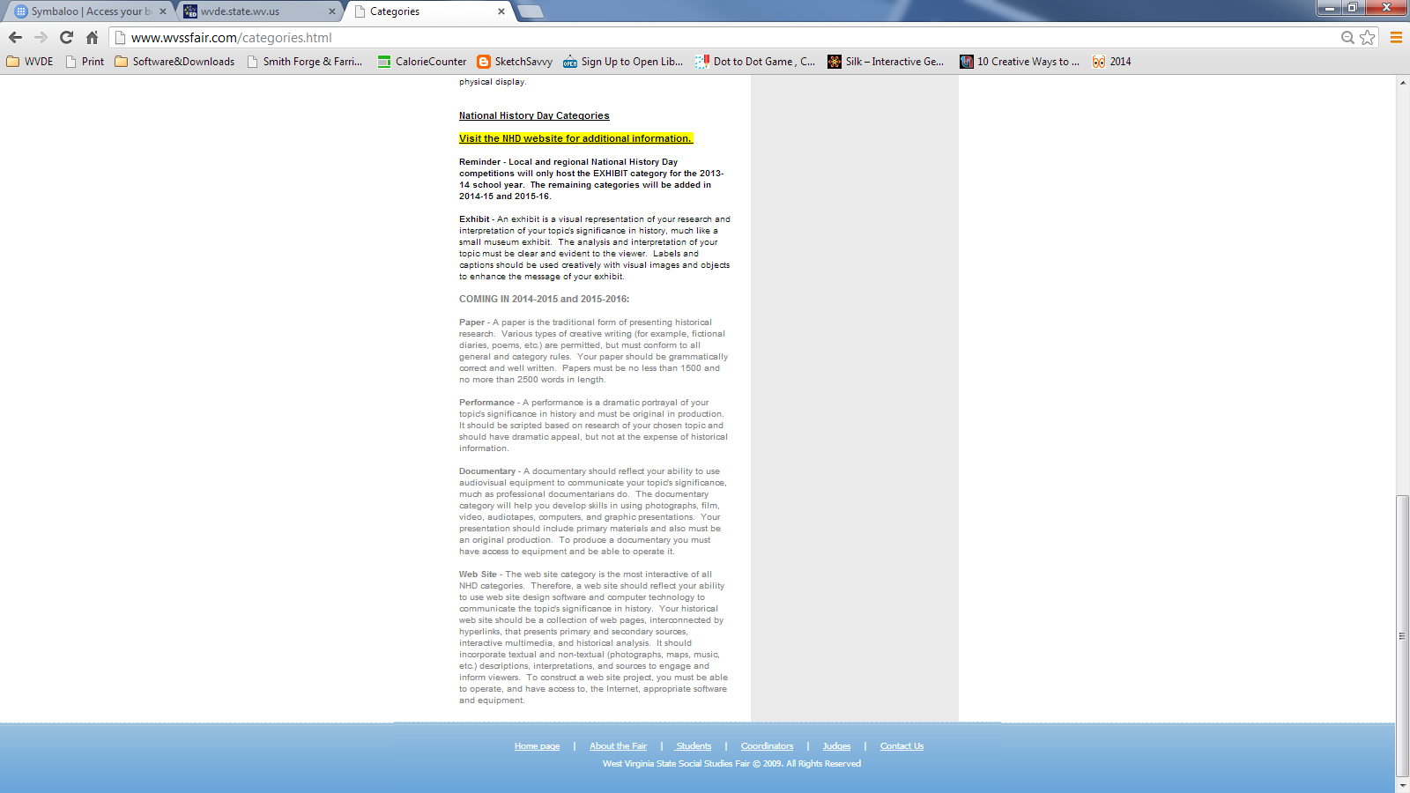
Categories

Slide 20
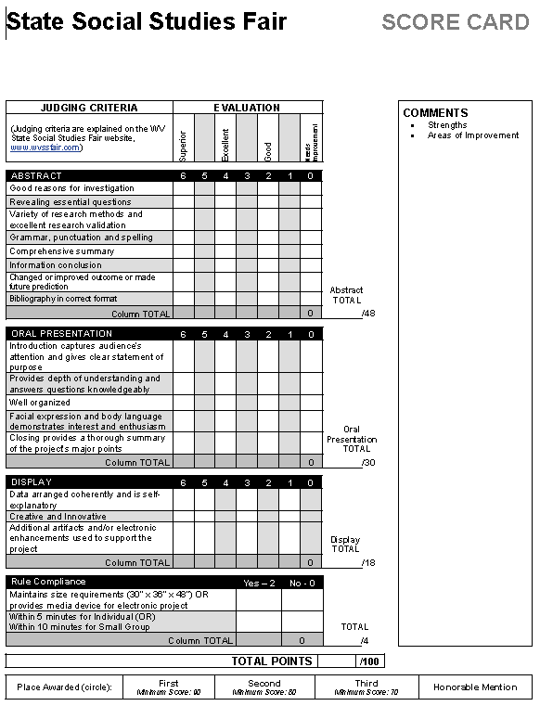
NEW Social Studies Fair Score Card

Slide 21
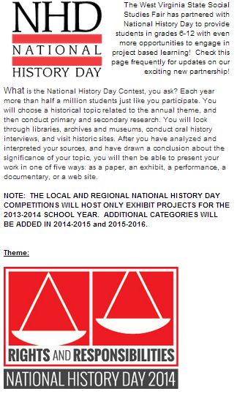
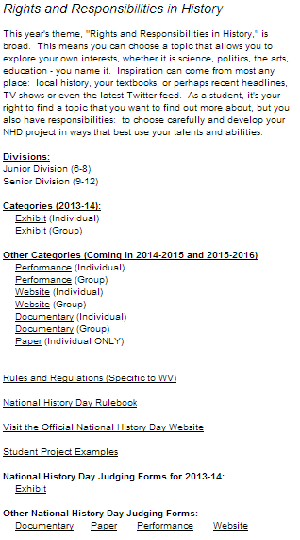

Slide 22
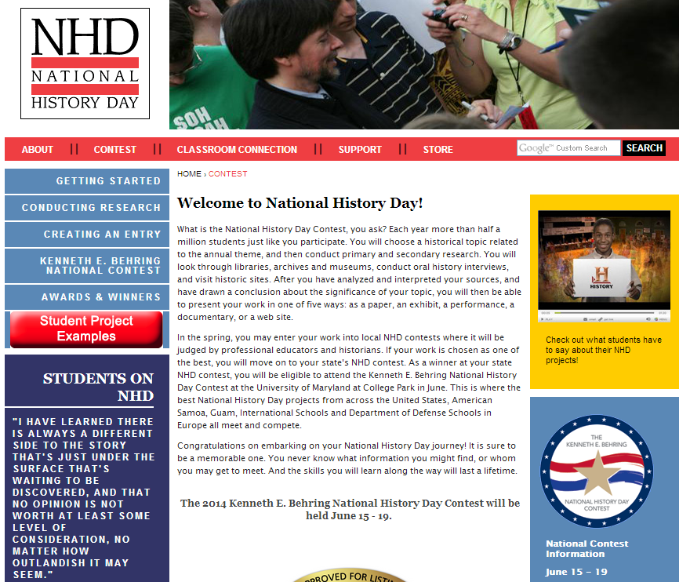

Slide 23
NHD Theme:
Rights and Responsibilities in History
Q: Do projects need to address BOTH rights and responsibilities within a single topic? Based on the sample topics lists for this year, it looks to me like some topics just address rights OR responsibilities, not both.
A: There is no single interpretation of any of the NHD themes – the goal is to create a lens through which students can analyze their topics. Realistically, many topics will touch on both rights and responsibilities, but that is NOT a requirement.
When considering a topic, here are some questions to consider:
  What is the struggle between those who have power and those who don’t?
  What are we required to give to the community? What are we entitled to be given?
  How do we balance the rights of the individual with the rights of the group?
  What responsibilities do we have to protect those who cannot protect themselves?
  What are the limits to rights? Where should the lines be drawn?

Slide 24
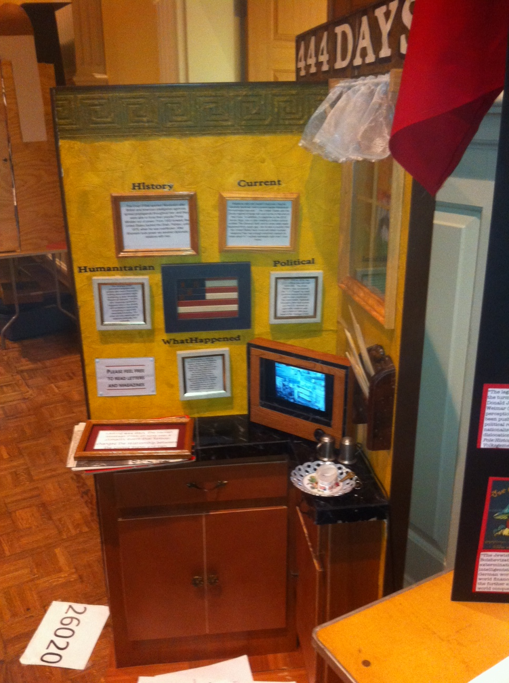
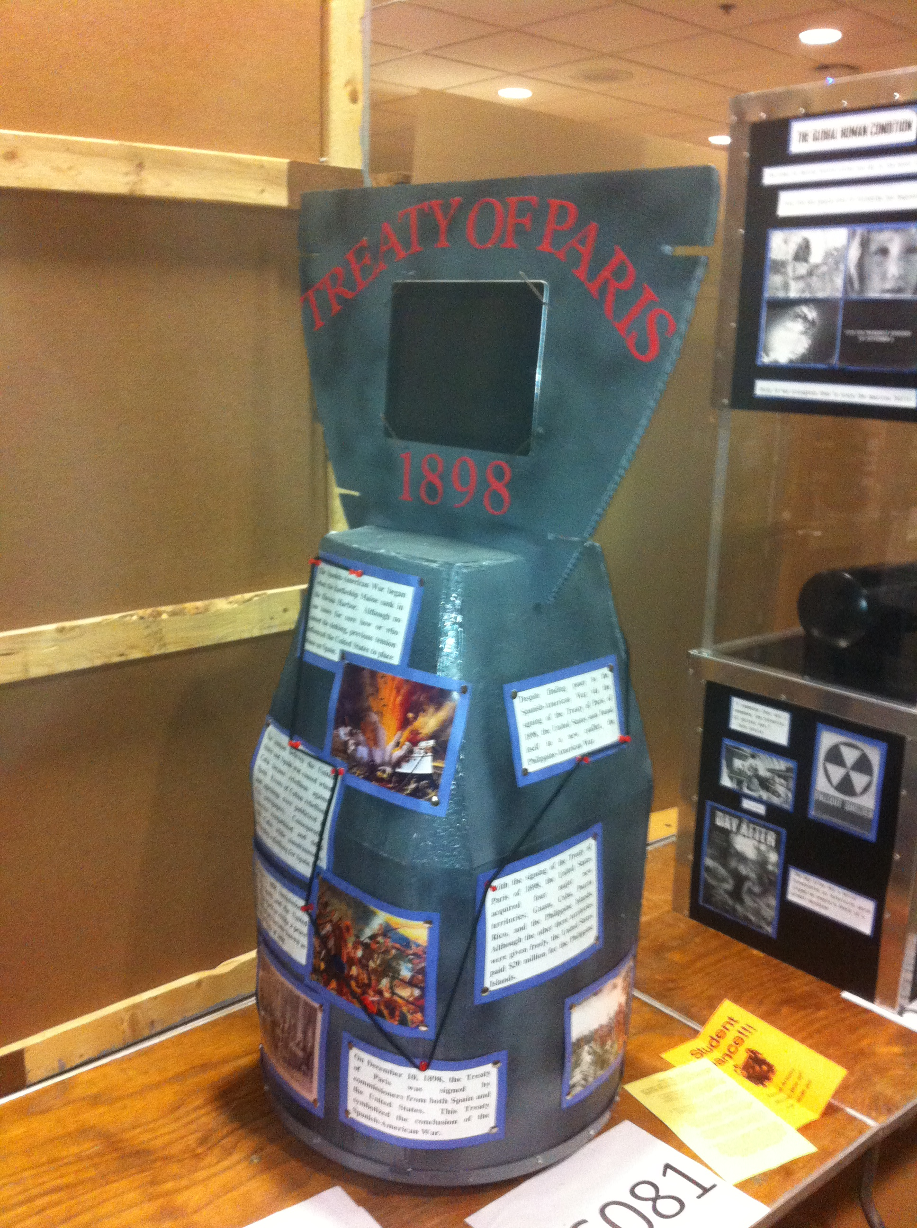
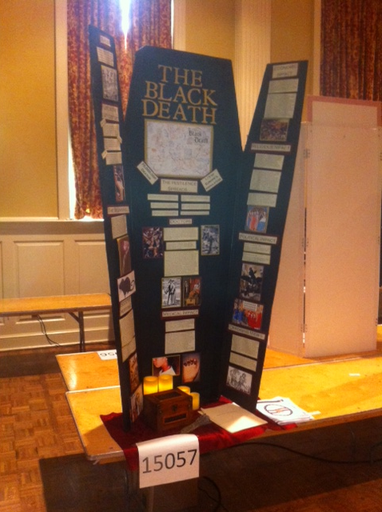

Slide 25
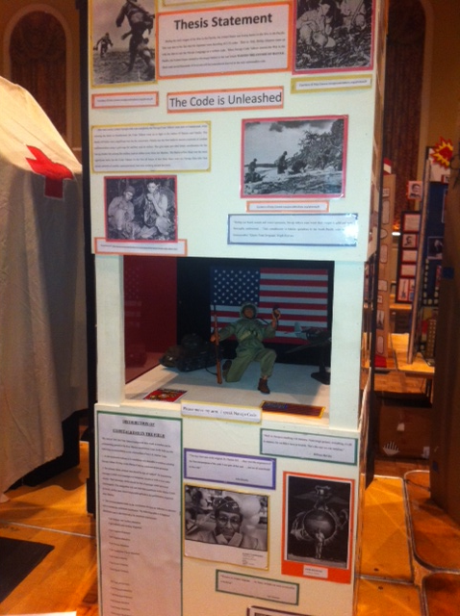
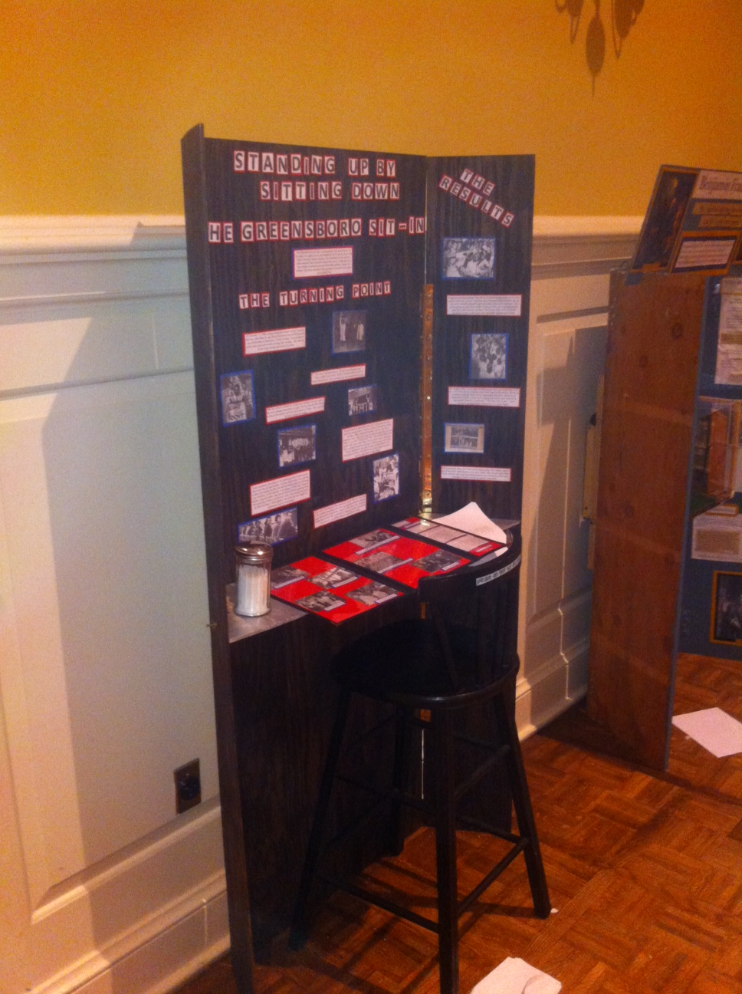
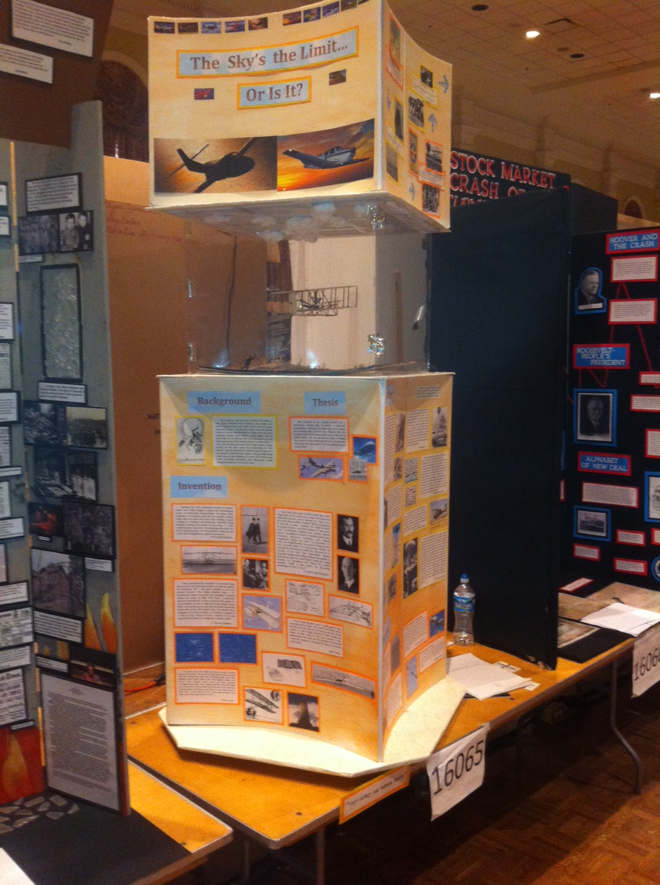

Slide 26
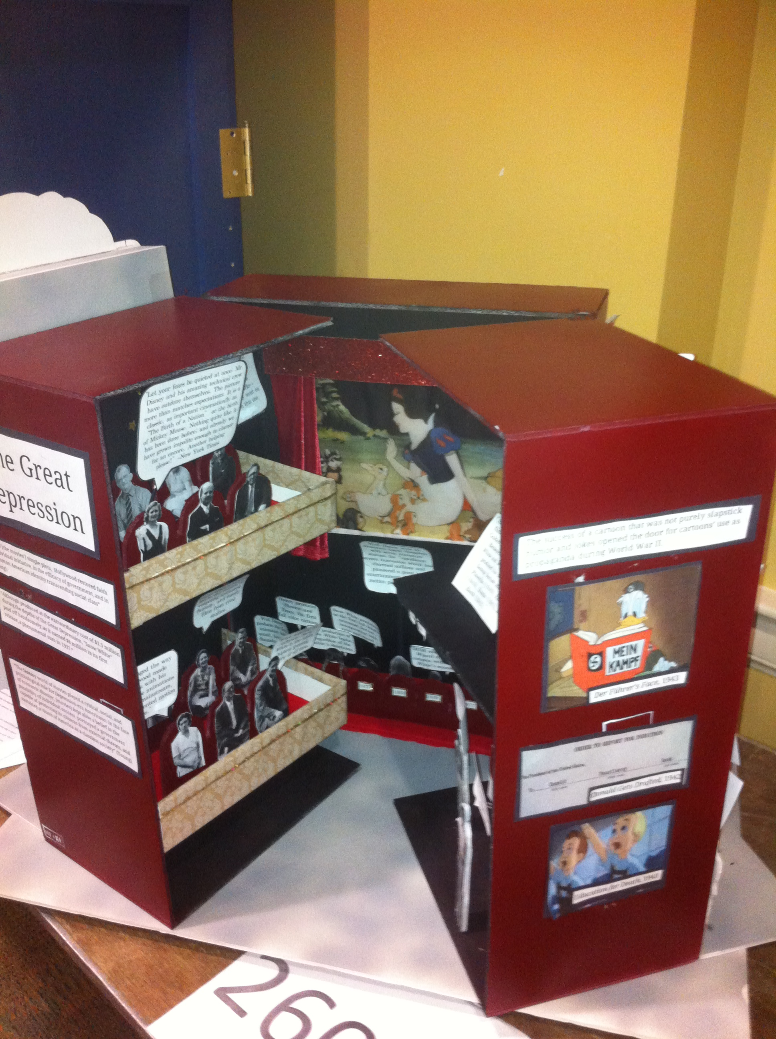
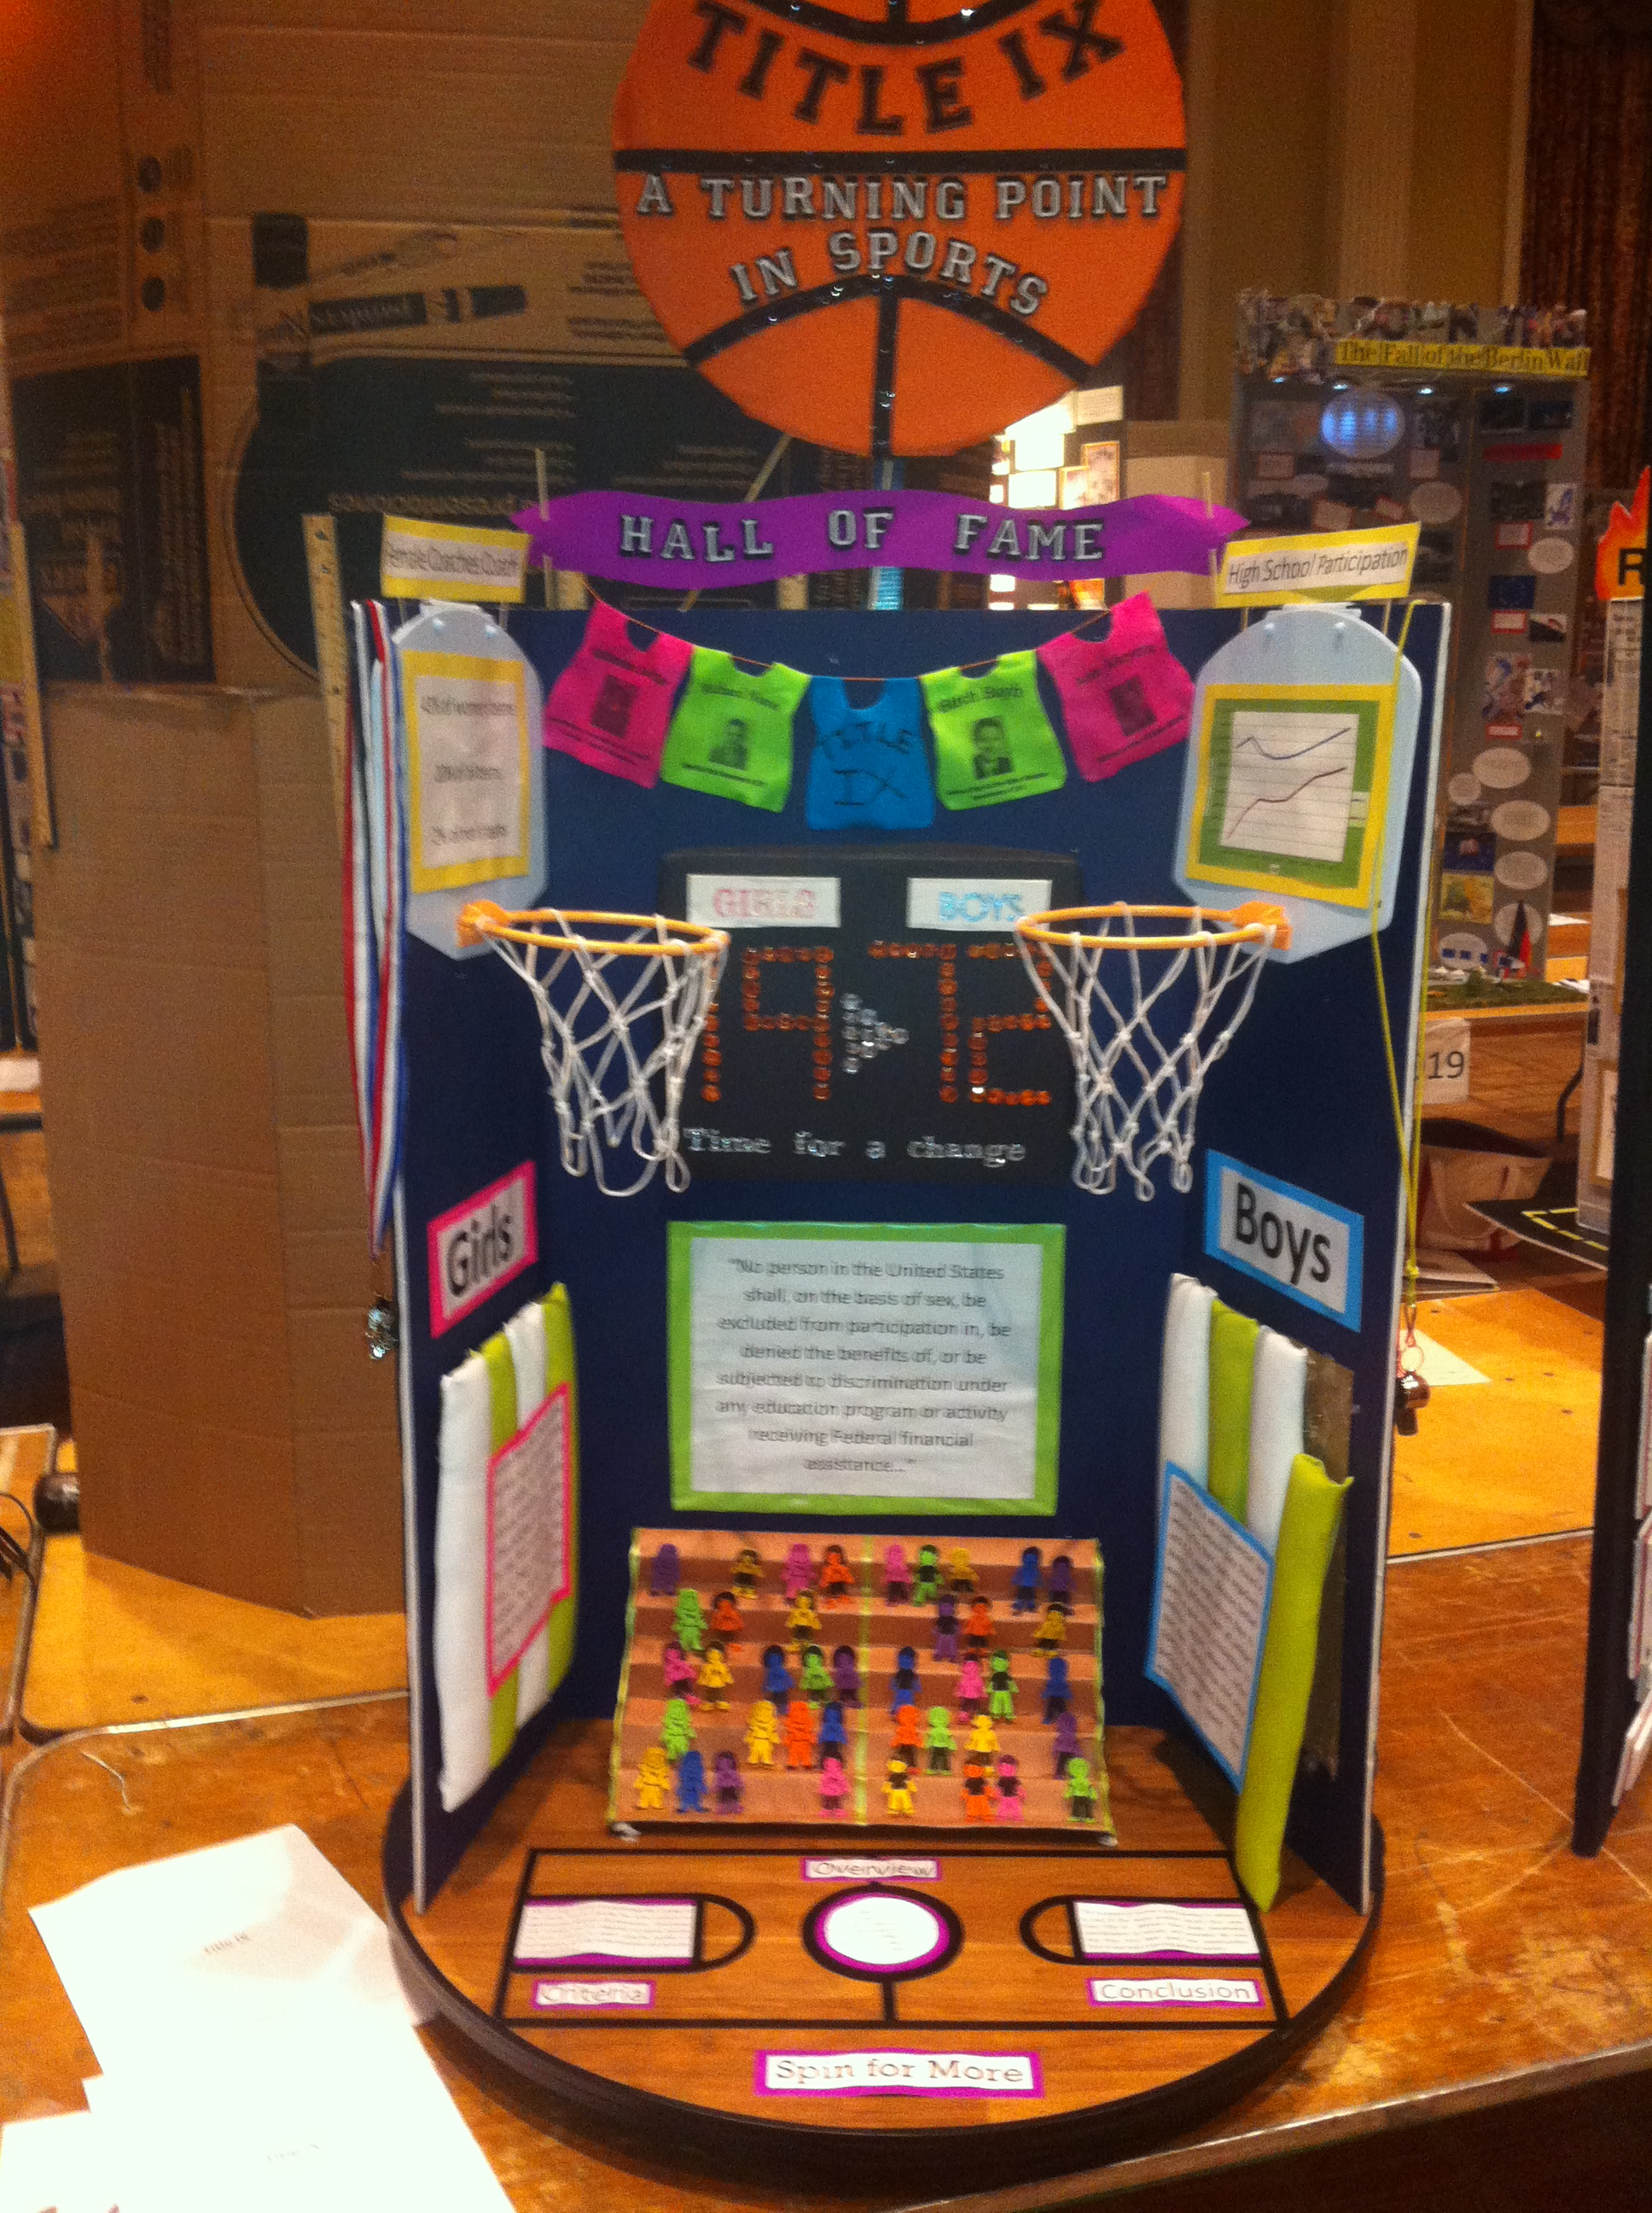

Slide 27
Rules & Regulations
The WV State Social Studies Fair is very excited to be partnered with National History Day, a nationwide academic competition that provides students in grades 6-12 with another unique opportunity for project-based learning. Winning projects at the state level competition may advance to a national competition. As a result, students who participate in National History Day must follow a different set of rules than those participating in the traditional WV State Social Studies Fair categories.
The rules are divided into 2 main sections: Social Studies Fair (SS) and National History Day (NHD).

Slide 28
Rules and Regulations for the 2014 WV State Social Studies Fair
I. Levels of Authority
SS1. The fair coordinator (school, county, RESA or state) has the final decision on matters pertaining to the fair regulations.
SS2. Disqualification of projects not meeting the project rules is the responsibility of the fair coordinator(s).
SS3. Any challenge at the school, county, RESA and/or state level must be submitted with 1 business day following the fair.
SS4. The fair coordinator at each level of competition (school, county, RESA or state) has sole and final authority to resolve issues, concerns, conflicts, or disputes at that level of competition. State fair coordinators will not intervene in issues at school, county or RESA fairs.

Slide 29
II. General Rules
SS5. Each project must include a physical display, oral presentation, and written abstract (in the approved format with a complete bibliography). A project that does not include all three of the required components shall be disqualified from competition.
SS6. Emphasis must be on methods of research, inquiry, creative problem solving and predictions regarding the issues rather than on “displays” or “collections of artifacts.”
SS7. Projects must clearly demonstrate a social studies component that shows a connection to humanity.
SS8. Student, school or county names must not appear on any part of the project/abstract with the exception of projects about community/family histories or international projects.
SS9. Students may ask others to help and direction, but they must do all of the work themselves.
SS10. Projects may be modified/improved between each level of competition; however, the theme must be maintained.
SS11. A student may enter only ONE project.
Notes:
SS11. For example, a student participating in a small group project may not enter a second project in the fair as an individual or a member of another small group. Students participating in the NHD competition may not enter a project in the WV State Social Studies Fair and vice versa.

Slide 30
III. Registration
SS12. The registration process for school and county fairs will be determined by the school/county fair coordinator.
SS13. County fair coordinators are responsible for registering projects for RESA-level fairs using the WV State Social Studies Online Registration System at www.wvssfair.com.
SS14. RESA fair coordinators are responsible for registering projects for the State Social Studies Fair.
SS15. At the State Social Studies Fair, students are not required to register / “check-in” on the day of the fair. Upon arrival, students may proceed directly to their assigned project numbers and assemble their projects. Project numbers will be posted to www.wvssfair.com at least one week prior to the date.
SS16. It is the responsibility of the fair coordinator (county or RESA) to insure the accuracy of registration information (student names, project titles, category selections, etc.) prior to submission.
Notes:
SS13. Detailed information on the use of the online registration system will be provided to county and RESA fair coordinators.
SS14. Detailed information on the registration process will be provided to RESA fair coordinators.

Slide 31
IV. Levels of Competitions
SS17. There will be four levels of competition: school, county, regional (RESA), and state.
SS18. Counties may send only their 1st place winners in each Division, Category and Type to the RESA district fair. RESA districts may send only their fist place winners in each Division, Category and Type to the State Fair in Charleston. A 1st place winner is defined as the highest scoring project in the Division/Category/Type with a score of 90 or above. A project must score a minimum of 90 out of 100 points to move on as a 1st place winner to the next level of competition. If no project scores 90 points or better in a certain category, then no project from that category will move on to the next level of competition.
SS19. In the event that a 1st place project at a regional fair is unable to attend the state fair, a 2nd place project may be substituted if:
1) The substitution is made BEFORE the regional fair coordinator submits project information to the State Social Studies Fair
AND
2) The second place project scored 90 or above at the regional fair.
No substitutions may be made after project information has been submitted to the state.

Slide 32
V. Project Classifications
SS20. All project must be classified by the exhibitor at the time of entry by division (grade level), category (subject), and type (individual or group).
SS21. Divisions: Division 1 (Grades 3-5) and Division II (Grades 6-8).
SS22. Categories: Anthropology, Economics, Geography, International, Political Science, Psychology, Sociology, State and Local Studies, U.S. History, World History/International Studies.
SS23. Types: Individual – Only 1 person worked on the project and presented it alone; Small group – 2 to 5 students worked on the project and will present the project together.
SS24. A RESA may submit no more than ONE 1st place project in each division / category / type for competition at the state fair. It is thus possible for a county to send 18 individual and 18 small group projects to the RESA district fair and the RESA could send 36 projects to the State Fair (18 individual and 18 small group).
SS25. Projects in a specific division / category/ type will compete only against other projects of the same division / category / type.
SS26. If a classification is questioned, a final determination will be made by the school, county, RESA or state coordinator.
Notes:
SS21. Has no high school because high school can only participate in NHD.
SS25. For example a project classified as Division I, Anthropology, Individual will only compete against other Division I, Anthropology, Individual projects.

Slide 33
VI. Project Displays
SS27. Each project must include a physical display.
SS28. A project display must be no larger than 30 in front to back, 36 in wide and 48 in high This display must be assembled on tables provided by the WV State Social Studies Fair. Students are NOT permitted to bring their own tables.
SS29. The space under the table directly beneath the project may be used for storage.
SS30. Items may hang from the front of the table (table cloths, charts, etc.)
SS31. Display items may NOT be placed in the aisle.
SS32. The physical display must be self-explanatory.
SS33. Items of value should NOT be left unattended with the project display. This includes computers, DVD players, MP3 players, digital photo frames, collectible items (coins, stamps, etc.), and any artifacts that might be easily pilfered. Such items should remain in the student’s possession at all times. Judges will allow time for students to return these items to the project display immediately prior to the oral presentation.

Slide 34
VII. Electronic Devices
SS34. Electronic devices (personal laptop, DVD player, MP3 players, cell phones, digital cameras, hand-held gaming equipment or audio recorders may be incorporated into the physical display and/or oral presentation. Electronic devices should not be left with the project display. Such items should remain in the student’s possession at all times.
SS35. Computer and electronic devices must be provided by the student.
SS36. Sound may be played at the time of the oral presentation ONLY. Volume must be limited so it does not interfere with other students’ presentations.
SS37. Electrical outlets will NOT be provided for project displays. All electronic devices must be battered operated.
SS38. An internet connection may be used as part of a project display ONLY if the student provides a means of connecting (laptop air card or phone with 3G connectivity). At the State level competition, use of the Charleston Civic Center’s internet connection (wireless or wired) will not be authorized under any circumstances.

Slide 35
VIII. Written Abstracts
SS39. Each project must have a written abstract in the approved format (see abstract template). The abstract must remain with the project display at all times.
SS40. Abstracts may be handwritten or typed.
SS41. Points may be deducted for grammatical and spelling errors.
IX. Oral Presentation
SS42. All projects will include an oral presentation. Participants should notify fair officials IMMEDIATELY if they are denied the opportunity to deliver their complete oral presentation.
SS43. Oral presentations for individual projects must not exceed 5 minutes. Oral presentations for small group projects must not exceed 10 minutes in length. The question and answer period is not included in the oral presentation time limit.
SS44. Each student participant in a small group must have a speaking part in the oral presentation.
SS45. Each student should be prepared to respond to questions from judges.
SS46. If a member of the small group has an acceptable excuse for being unable to attend, the other members of the group may represent the project.
SS47. Oral presentations may not be pre-recorded unless they are by members of a project in the international category residing outside the U.S.
Notes:
SS39. We recommend that students bring multiple copies with them.

Slide 36
X. Judging and Awards
SS48. Each project at the state level competition will be assigned a judging time and project number. Project numbers will be posted to the State Studies Fair website, www.wvssfair.com, at least one week prior to the fair date. Judging times will NOT be provided prior to the fair date. Requests for time changes or for specific judging times will NOT be honored.
SS49. First, second, and third place may be given to the highest scoring projects in each Division/Category/Type that meet minimum score requirements. A project must score a minimum of 90 points out of 100 points to be identified as a 1st place winner, 80/above to be identified as a 2nd place winner, 70/above to be identified as a 3rd place winner. Because of the minimum score requirements, it’s possible for a category to have no winning projects. Honorable mention awards are granted upon the judges’ recommendation and are not dependent upon the score.
SS50. Ties for 1st, 2nd and 3rd place awards are not permitted at the school, county RESA or state level.
SS51. At the State Social Studies Fair, winning projects will be identified with a ribbon/sticker prior to the public viewing. Only those students whose projects are identified with a sticker/ribbon are required to remain for the award ceremony. Students who are unable to attend the award ceremony must identify someone to receive their award. Awards will NOT be mailed.

Slide 37
X. Judging and Awards Continued
SS52. Access to the project display room is limited to fair officials, judges and students during the scheduled judging period. Parents and teachers may not accompany students into the project display area during the scheduled judging period.
SS53. Projects may not be removed until after the public viewing. Students who are unable to retrieve their projects following the public viewing and awards ceremony must identify someone to do so. Anything left at the fair will be discard at the conclusion of the event.
SS54. Projects that win first place at the state level will not be eligible to compete in school, county, RESA or state fairs in subsequent years.
SS55. Issues/concerns about the judging process, particularly those issues related to oral presentations, must be addressed with the fair coordinator immediately. It is often impossible to resolve such matters after a category has closed and judges have been dismissed.
SS56. At the state level, student copies of the score cards will be provided to the county fair coordinators ONLY. Score cards will not be released to students/parents.
Notes:
SS56. Score cards are emailed directly to the county coordinators. We do not send paper copies of the score cards any longer.

Slide 38
XI. Prohibited Items
SS57. The following are prohibited at all levels of competition (school, county, RESA and state):
a. Live animals
b. Flames, highly flammable materials, or sources of heat (hot plates, etc.)
c. Dry ice
d. Weapons and ammunition (including toys and replicas)
e. Sharp items (for example: syringes, needles, knives)
f. Tobacco products
g. All hazardous substances or devices (for example: chemicals, poisons and drugs)
h. Batteries with open-top cells (for example: car and motorcycle batteries.
i. Any item prohibited by WV Board of Education Policies.
j. Any item that the fair coordinator deems unsafe or inappropriate for public display.

Slide 39
Rules and Regulations for the 2014 WV State History Day Competition
I. Levels of Authority
NH1. The State Social Studies Fair coordinator has the final decision on matters pertaining to the fair if these matters are not covered in fair regulations.
NH2. Disqualification of projects not meeting the project rules is the responsibility of the fair coordinator(s).
NH3. Any challenge at the state level competition must be submitted within 1 business day following the fair

Slide 40
II. General Rules
NH4. Projects competing in the state level National History Day (NHD) competition must abide by all rules and regulations for the national level National History Day competition as established in the NHD Rules Handbook, www.wvssfair.com / www.nhd.org.
NH5. In addition to the rules in the NHD Handbook, projects competing in the state level competition must also abide by all NHD rules in this document (identified by the NH designation in the rule number – NH1, NH2, etc.) These rules are additions to the NHD rules and are not meant to replace them. Rules in this document with the SS designation (SS1, SS2, etc) do NOT apply to NHD projects.
III. Registration
NH6. County social studies coordinators will be responsible for registering projects for the state NHD competition at the middle school level. RESA coordinators will be responsible for registering NHD projects at the high school level. Information on the registration procedure will be posted to the WV State Social Studies Fair website, www.wvssfair.com.
NH7. At the State Social Studies Fair, students are not required to register or “check in” on the day of the fair. Upon arrival, students may proceed directly to their assigned project numbers and assemble their projects. Project numbers will be posted to www.wvssfair.com at least one week prior to the fair date.
NH8. It is the responsibility of the county and RESA social studies coordinator to insure the accuracy of registration information (student names, project titles, category selections, etc.) prior to submission.
Notes:
SS56. Score cards are emailed directly to the county coordinators. We do not send paper copies of the score cards any longer.

Slide 41
IV. Levels of Competition
NH9. For the 2013-2014 school year, the NHD is the only option for students in grades 9-12 (NHD Senior Division). Students in the Senior Division must compete at school, county and regional competitions before progressing to the state competition.
NH10. For the 2013-14 school year ONLY, ALL students in grades 6-8 (NHD Junior Division), who compete a NHD project will progress directly to the state-level competition. There will be no school, county or regional level NHD competitions this year. Registration for these projects will be the responsibility of county and RESA social studies fair coordinators.
V. Project Displays
NH11. Project displays must adhere to the size restrictions established in the NHD Rules Handbook.
NH12. Display items may NOT be placed in the aisle.
NH13. Items of value should not be left unattended with the project display. Such items should remain in the student’s possession at all times.
Notes:
SS56. Score cards are emailed directly to the county coordinators. We do not send paper copies of the score cards any longer.

Slide 42
VI. Electronic Devices
NH14. Electronic devices (personal laptop, DVD player, MP3 players, cell phones, digital camera, hand-held gaming equipment or audio recorders may be incorporated into the physical display and/or oral presentation. Electronic devices should not be left with the project display. Such items should remain in the student’s possession at all times.
NH15. Computers and other electronic devices must be provided by the student.
NH16. Sound may be played at the time of the oral presentation ONLY. Volume must be limited so it does not interfere with other students’ presentations.
NH17. Electrical outlets will be provided for project displays for NHD PROJECTS ONLY.
NH18. Internet will be provided for NHD projects ONLY.
Notes:
SS56. Score cards are emailed directly to the county coordinators. We do not send paper copies of the score cards any longer.

Slide 43
VII. Judging and Awards
NH19. Each project at the state level competition will be assigned a judging time and project number. Project numbers will be posted to the State Social Studies Fair website, www.wvssfair.com, at least one week prior to the fair date. Judging times will NOT be provided prior to the fair date. Requests for time changes/for specific judging times will NOT be honored.
NH20. Ties for 1st, 2nd or 3rd place awards re not permitted.
NH21. At the State Social Studies Fair, winning projects will be identified with a ribbon/sticker prior to the public viewing. Only those students whose projects are identified with a sticker/ribbon are required to remain for the awards ceremony. Students who are unable to attend the awards ceremony must identify someone to receive their award. Awards will NOT be mailed.
NH22. Access to the project display room is limited to fair officials, judges, and students during the scheduled judging period. Parents and teachers may not accompany students into the project display area during the scheduled judging period.
Notes:
SS56. Score cards are emailed directly to the county coordinators. We do not send paper copies of the score cards any longer.

Slide 44
VII. Judging and Awards Continued
NH23. Projects may not be removed until after the public viewing. Students who are unable to retrieve their projects following the public viewing and awards ceremony must identify someone to do so. Anything left at the fair will be discarded at the conclusion of the event.
NH24. Issues/concerns about the judging process, particularly those issues related to oral presentations, must be addressed with the fair coordinator immediately. It is often impossible to resolve such matters after a category has closed and judges have been dismissed.
NH25. At the state level, student copies of score cards will be provided to county fair coordinators ONLY. Score cards will not be released directly to students/parents.
NH26. NHD projects that receive a 1st/2nd place award at the state level competition may choose to advance to the national competition at the University of Maryland. A project must score a minimum of 90 points out of 100 to be identified as a 1st place winner, 80/above for 2nd place and 70/above for 3rd place. IN ORDER TO ADVANCE TO NATIONAL LEVEL COMPETITION, NHD WINNERS MUST BE PRESENT AT THE AWARDS CEREMONY AND MUST ATTEND A MANDATORY INFORMATIONAL MEETING IMMEDIATELY FOLLOWING THE CEREMONY.
Notes:
SS56. Score cards are emailed directly to the county coordinators. We do not send paper copies of the score cards any longer.

Slide 45
VII. Prohibited Items
NH27. The following are prohibited at all levels of competition (school, county, RESA and state):
a. Live animals
b. Flames, highly flammable materials, or sources of heat (hot plates, etc.)
c. Dry ice
d. Weapons and ammunition (including toys and replicas)
e. Sharp items (for example: syringes, needles, knives)
f. Tobacco products
g. All hazardous substances or devices (for example: chemicals, poisons and drugs)
h. Batteries with open-top cells (for example: car and motorcycle batteries.
i. Any item prohibited by WV Board of Education Policies.
j. Any item that the fair coordinator deems unsafe or inappropriate for public display.
Notes:
SS56. Score cards are emailed directly to the county coordinators. We do not send paper copies of the score cards any longer.

Slide 46
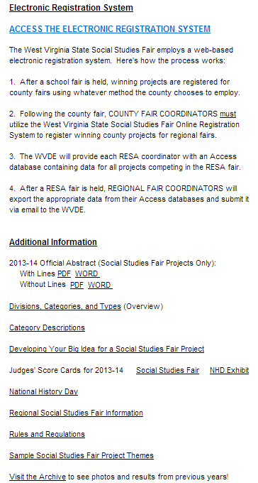
Information for Coordinators

Slide 47
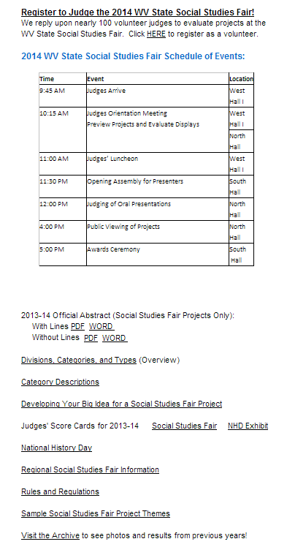
Information for Judges

Slide 48
NHD Advancements
For 2013-2014, counties and RESAs are only required to host the exhibit portion of the National History Day Competition at their county and regional fairs.
Therefore, counties and RESAs need to establish the number of high school National History Day projects they wish to advance to the regional competition since there will only be one category for high school students.
At the regional fair level, RESA coordinators will be able to advance up to four National History Day exhibit projects to the state competition.

Slide 49
FAQ
Q. Have social studies fair rules changed for elementary and middle school students?
NO, however there is a new score card for the Social Studies Fair portion of the competition.
Can elementary and middle school students participate in the National History Day portion of the competition?
A. NHD does not have an elementary division. Middle school students who participate in the 2014 HD Competition will advance directly to the state fair. Middle school students who participate in the WV State Social Studies Fair will advance through the local, county and regional level competition as always.
Q. Can High School students enter projects other than exhibits in this year’s competition?
High school students who choose to create a performance, documentary or website will advance directly to the state fair. All exhibits must go through the local, county and regional competitions. We will not be accepting entries for the paper category this year.

Slide 50
FAQ Continued
How do I register a non-exhibit or a Middle School HD project?
County coordinators will be able to enter these projects directly to the Registration System. If there are problems, please email help@wvssfair.com.
Q. Why do High School students have to participate in NHD?
NHD makes history come alive by discovering historic, cultural and social experiences through hands on opportunities and presentations. It is an amazing competition with participates from all 50 states and various areas from around the world. Students who advance to the national competition are able to network with other students around the world and participate in a once in a lifetime event.

Slide 51
Notes:
Questions?

